Slide 1
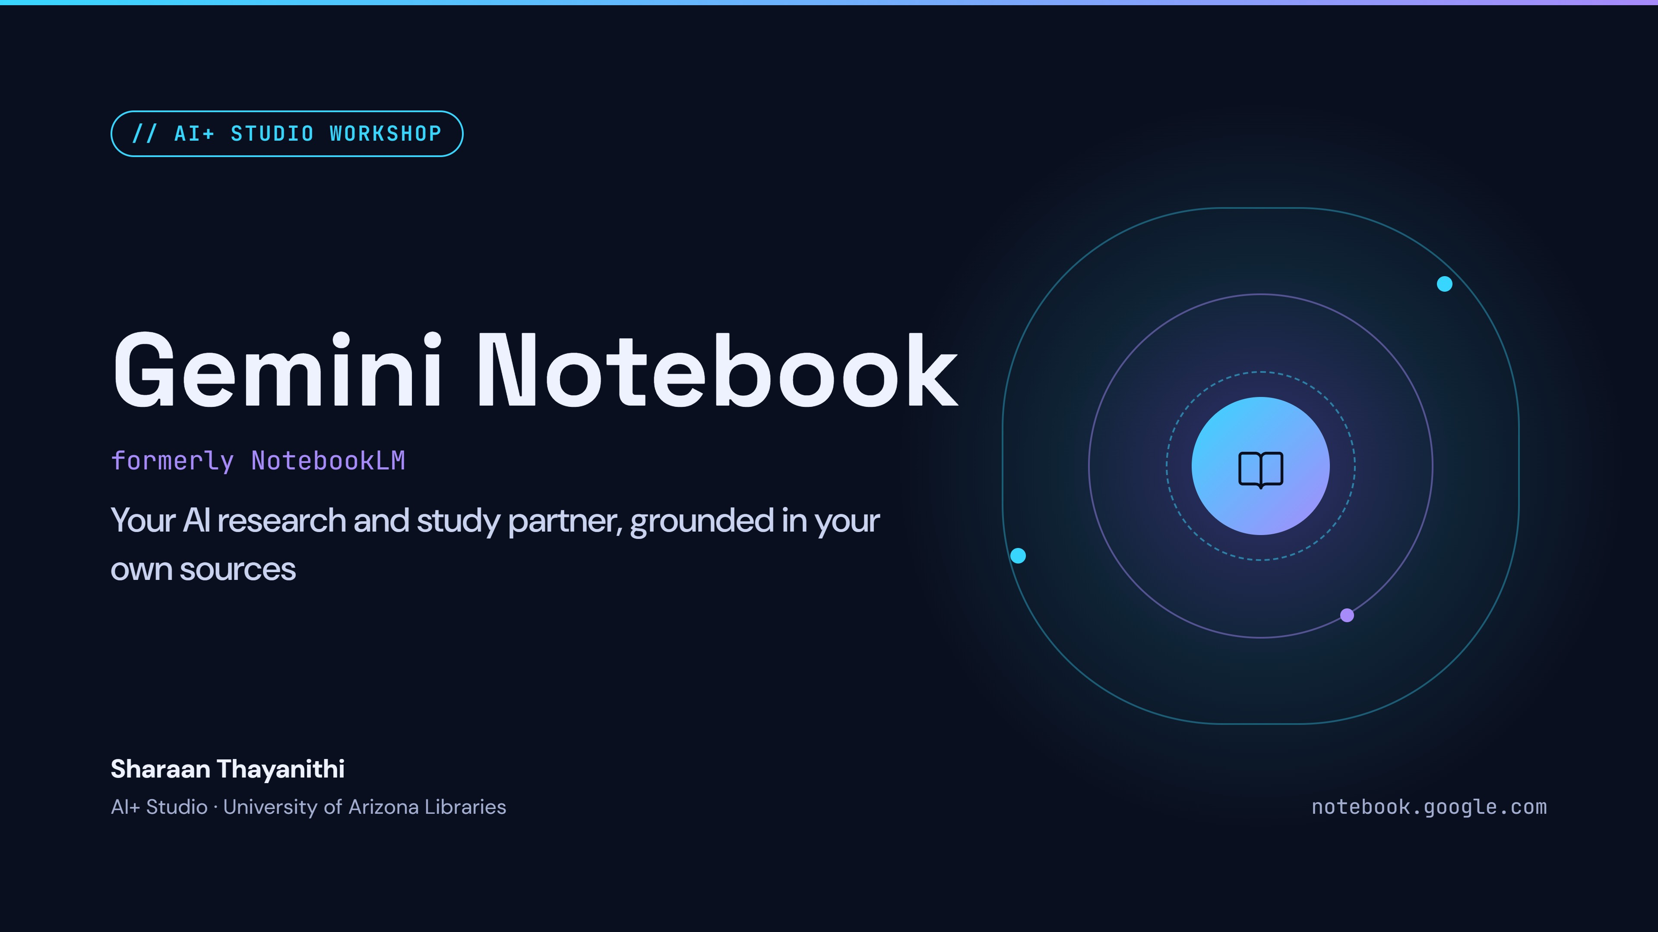
Notes:
Welcome everyone. Introduce yourself and the AI+ Studio. Today is a hands-on tour of Gemini Notebook, the tool formerly called NotebookLM, which turns your own class materials into cited answers and study tools. Ask people to open their laptops.

Slide 2
// WHO WE ARE
The AI+ Studio: how we help you
Harness the power of generative AI for innovation, learning, and discovery.
Use our local LLMs
Studio laptops run small AI models offline. No token limits, and your data never leaves the machine.
Talk to an AI specialist
Stop by the Ask Us @AI desk outside the Studio, or book a session at lbry-aistudio@arizona.edu.
Workshops and events
New AI tools for student success every week. Drop in, or join a scheduled workshop like this one.
Partner with us
Faculty, staff and campus groups can book the Studio for their own AI workshops, events or a game-show style AI challenge.
GEMINI NOTEBOOK WORKSHOP · AI+ STUDIO
02 / 24
Notes:
Quick plug for the AI+ Studio. Four ways we help: local LLMs on Studio laptops (great for trying AI with no limits and full privacy), the Ask Us @AI desk and 1:1 appointments at lbry-aistudio@arizona.edu, weekly workshops and drop-ins, and partnerships for faculty, staff and campus groups who want their own AI sessions or a game-show style AI challenge.

Slide 3
// GET STARTED
Start here: U of A GenAI
genai.arizona.edu
Free with your NetID
Private
Approved for university data
GEMINI NOTEBOOK WORKSHOP · AI+ STUDIO
03 / 25

Slide 4
// TODAY'S PLAN
What we’ll cover today
01
What it is
The rename, ways in, and how it differs from the Gemini app
02
The layout
3 segments of Gemini Notebook - Sources, Chat, Studio
03
Sources and research
Find, add and organize material with Fast and Deep Research
04
Chat and notes
Cited answers, saved notes and chat modes
05
Studio tools
Podcasts, quizzes, mind maps, reports and tables
06
Share and wrap up
Study together, use it responsibly, prompts to steal, Q&A
GEMINI NOTEBOOK WORKSHOP · AI+ STUDIO
04 / 24
Notes:
Walk through the six parts. Everyone should open notebook.google.com now and sign in with their UA NetID so they can follow along. If a login fails, they can watch the screen and try later.

Slide 5
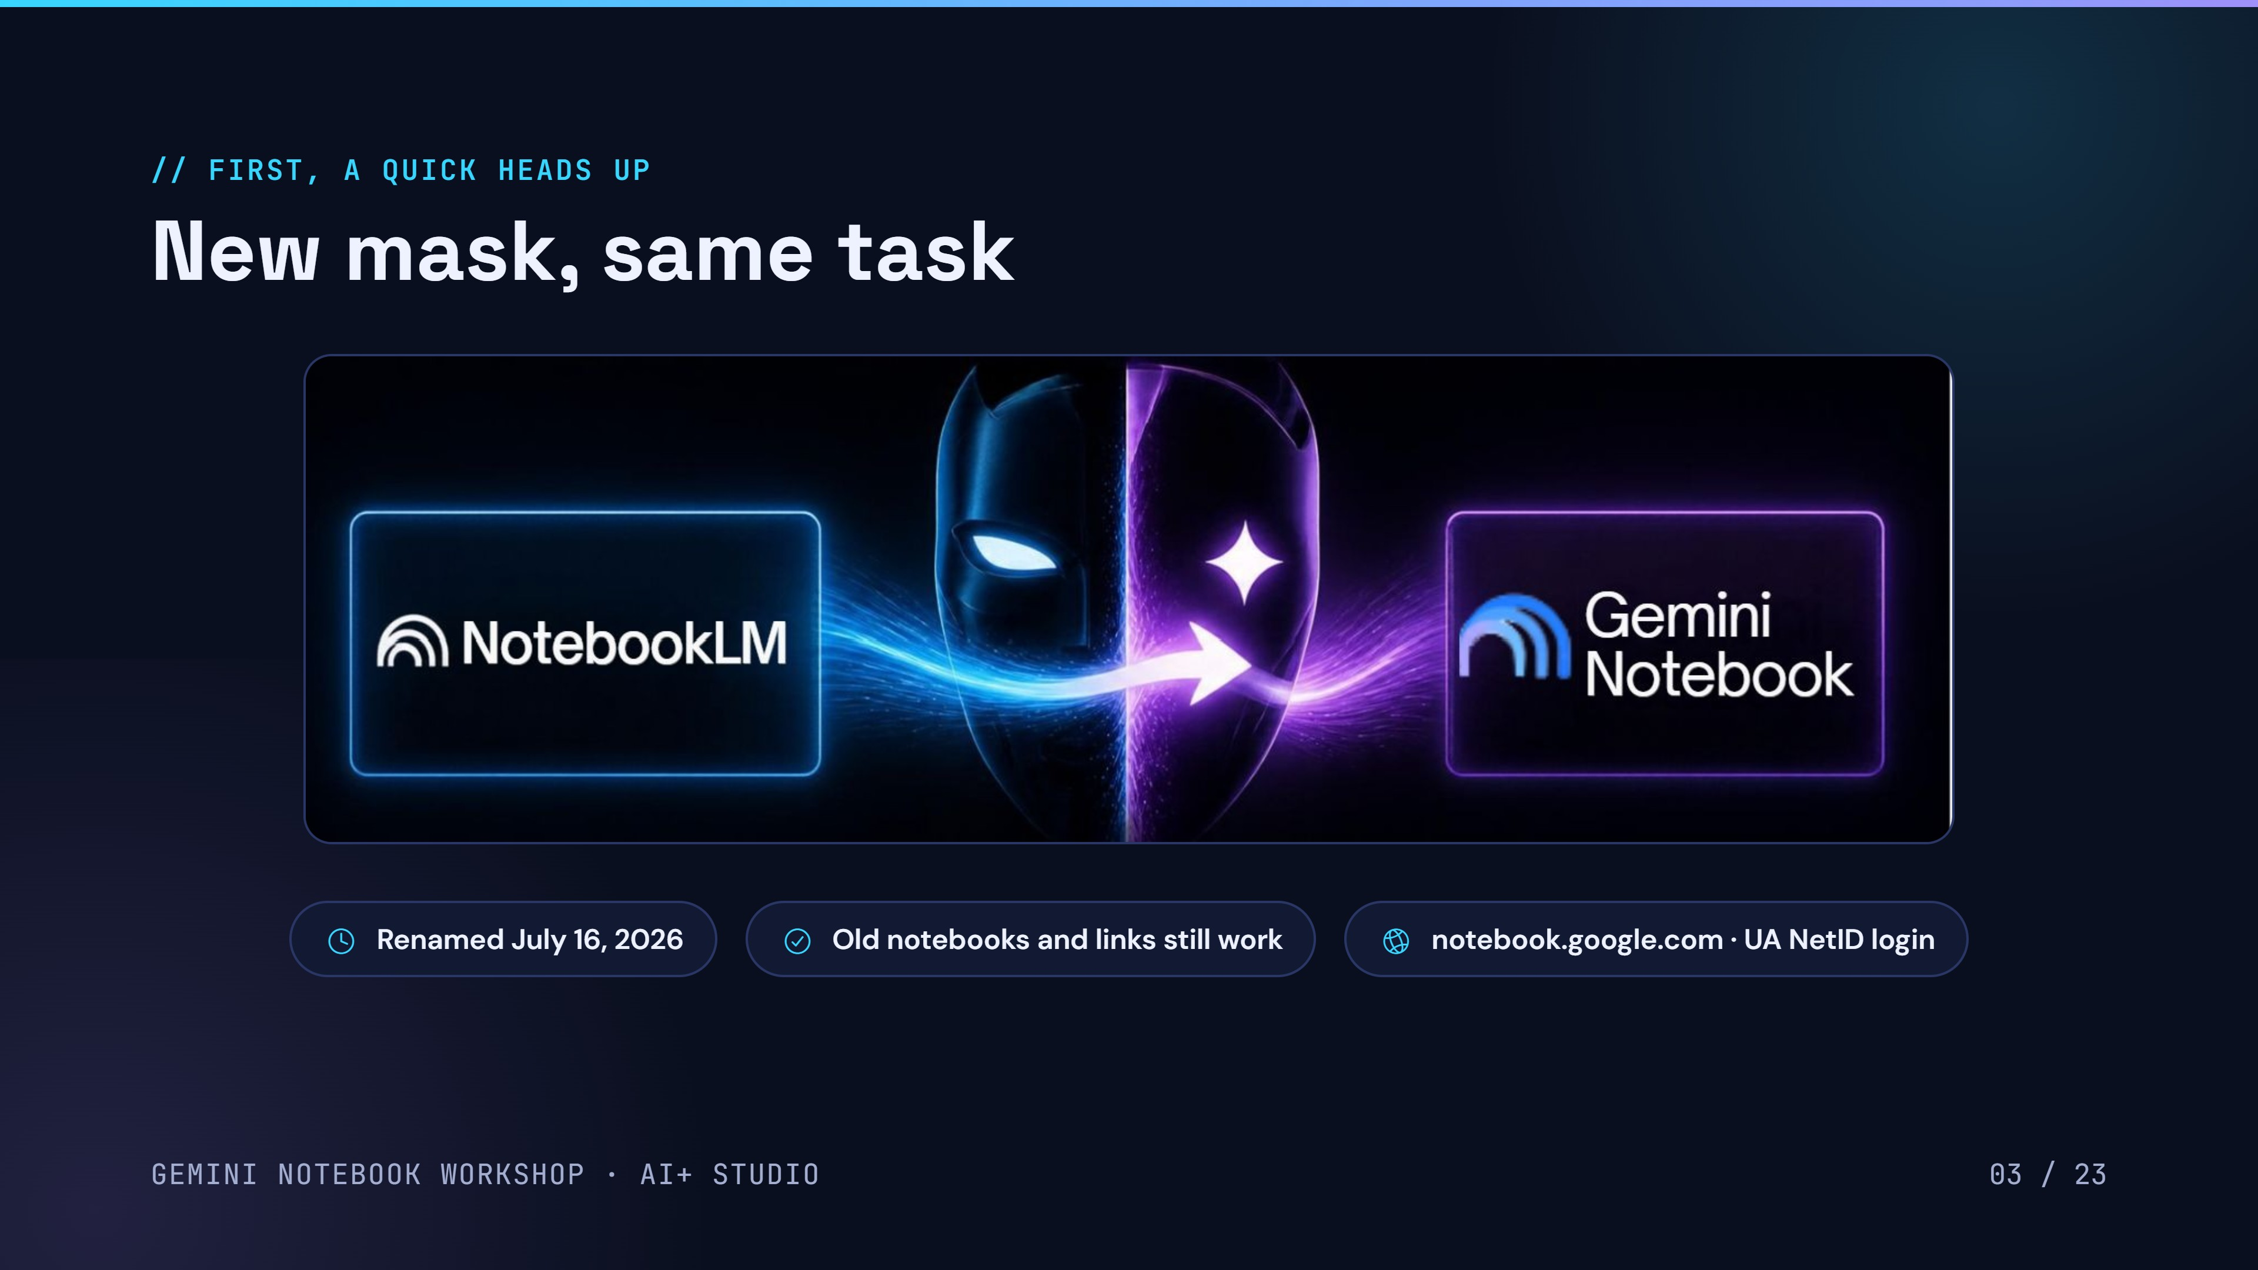
Unified under the Gemini brand for seamless integration across Google’s ecosystem
03 / 24
Notes:
Open with the meme. At San Diego Comic-Con 2024, Robert Downey Jr., who played Iron Man for over a decade, was revealed as Doctor Doom and told the crowd: new mask, same task. Same thing here. On July 16, 2026, Google renamed NotebookLM to Gemini Notebook. Same product underneath: your notebooks, sources and features carry over, and old links redirect to notebook.google.com. Tutorials online will still say NotebookLM, so both names are fine.

Slide 6
// GETTING IN
Three ways in: Web, Mobile app, Apps launcher
Same account, same notebooks. Pick the one that fits the moment.
On the web
On your phone
OPEN
GET IT
notebook.google.com in any browser
App name - Notebook
SIGN IN
NEEDS
Your UA NetID
iOS 17+ or Android 10+, free
BEST FOR
BEST FOR
Building and organizing notebooks
Listening audio overviews & quick questions
ANOTHER WAY IN
Open the Google launcher (9 dots), scroll down, select Notebook icon
GEMINI NOTEBOOK WORKSHOP · AI+ STUDIO
07 / 24

Slide 7
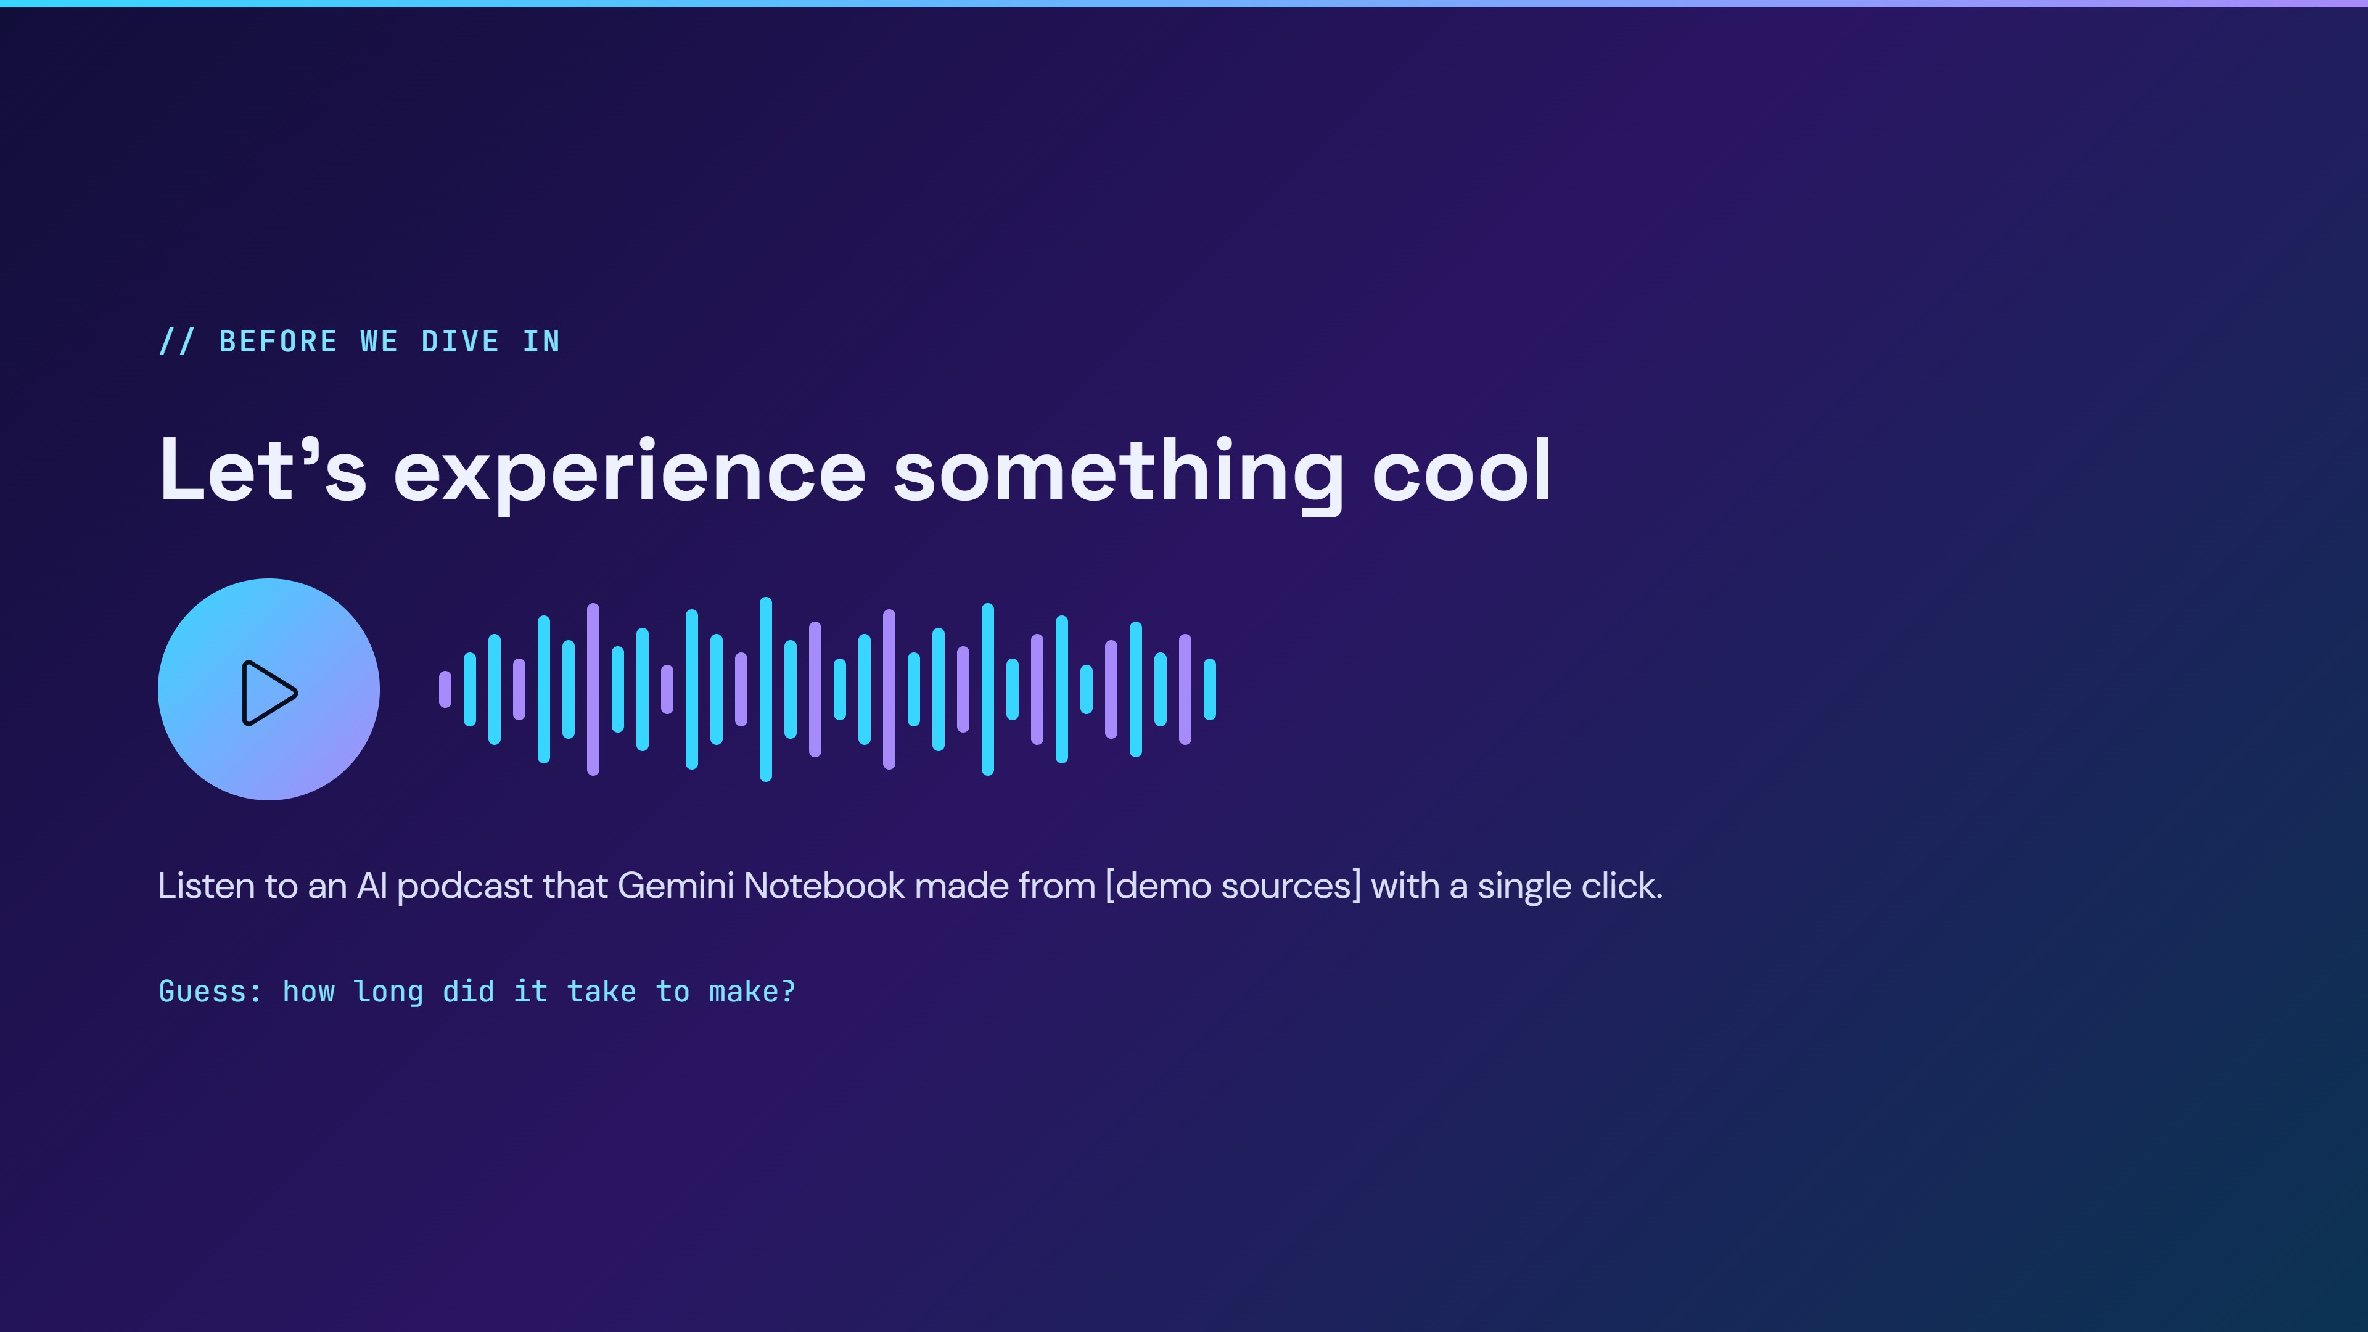
Listen to an AI podcast that Gemini Notebook made with a single click.
Notes:
The hook. Play 1 to 2 minutes of a pre-made Audio Overview. Ask the room to guess how long it took to make (answer: a few minutes, one click). Then say: by the end of today, you'll make one of these from your own notes.

Slide 8
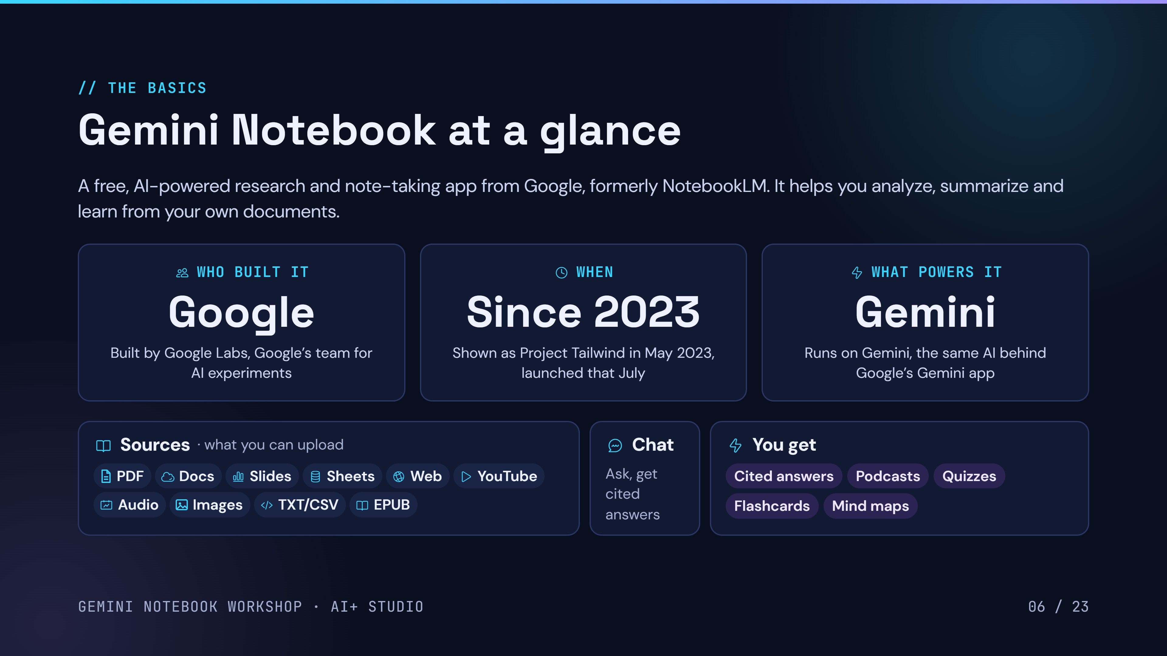
06 / 24
Notes:
Gemini Notebook is a free AI research and note-taking app from Google. Who: built inside Google Labs, Google's group for AI experiments; bestselling author Steven Johnson has been on the team since the start. When: shown at Google I/O in May 2023 as Project Tailwind, launched as NotebookLM that July, renamed in July 2026. What powers it: Google's Gemini models. Bottom row: what you can upload, where you chat, and what you get out.

Slide 9
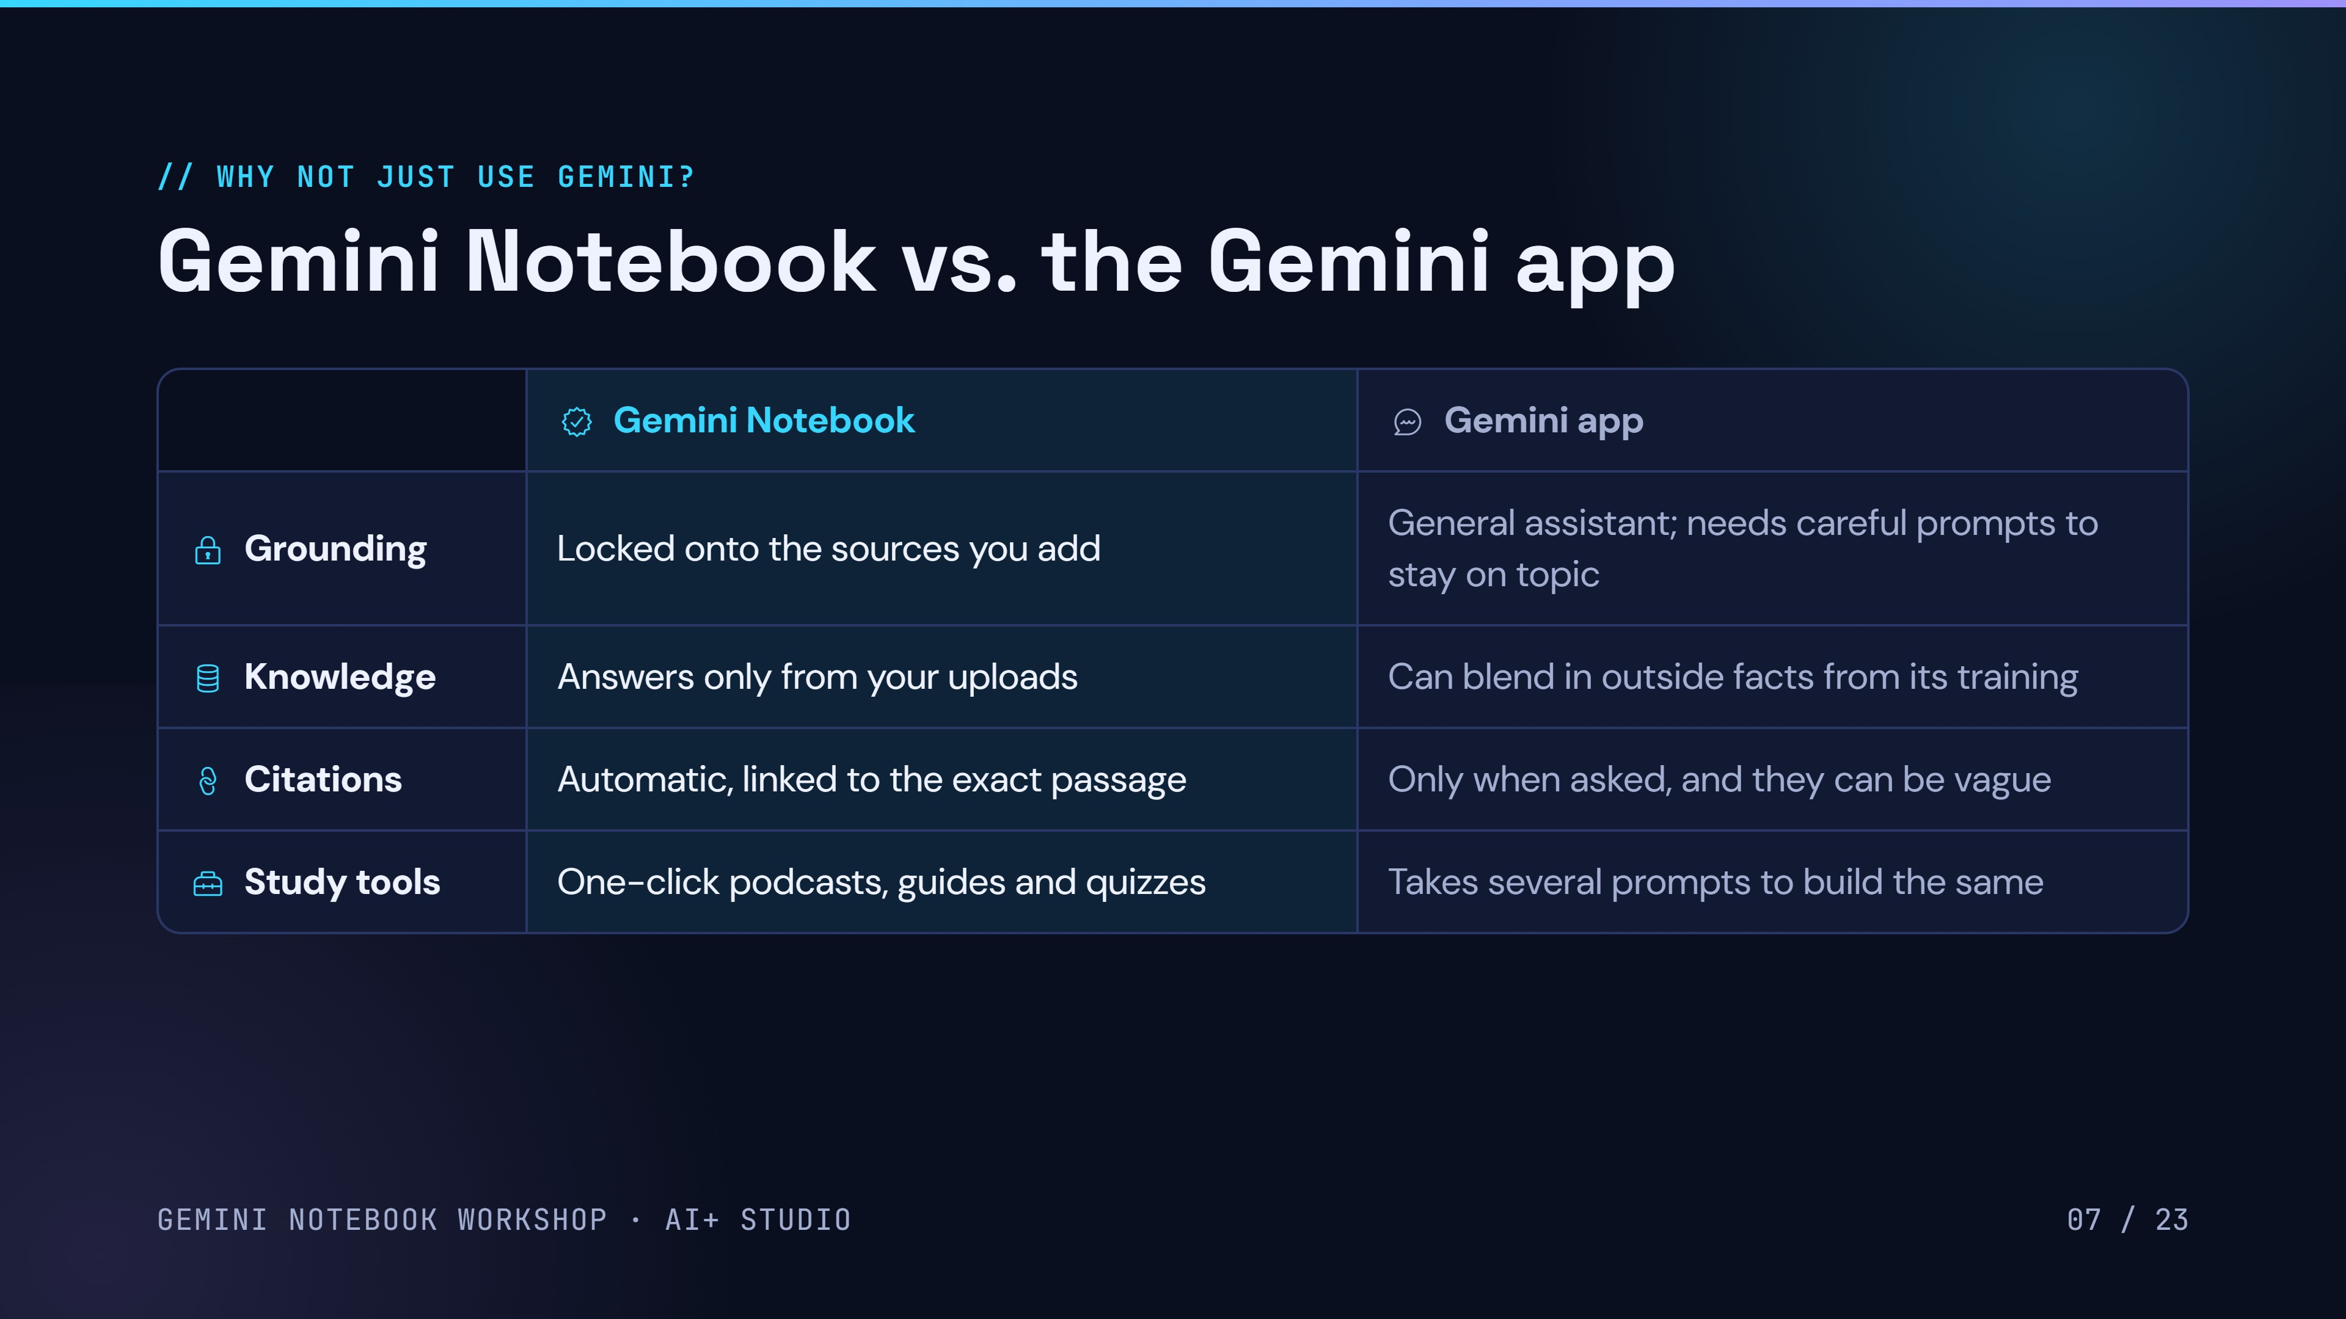
08 / 24
Notes:
Both run on Gemini, but they're built for different jobs. Gemini Notebook is locked onto the sources you upload, answers only from them, cites the exact passage automatically, and has one-click study tools. The regular Gemini app is a general assistant: it draws on everything it learned in training, cites only when it searches or you ask, and needs more prompting to build study material. You can also attach a notebook to a Gemini app chat.

Slide 10
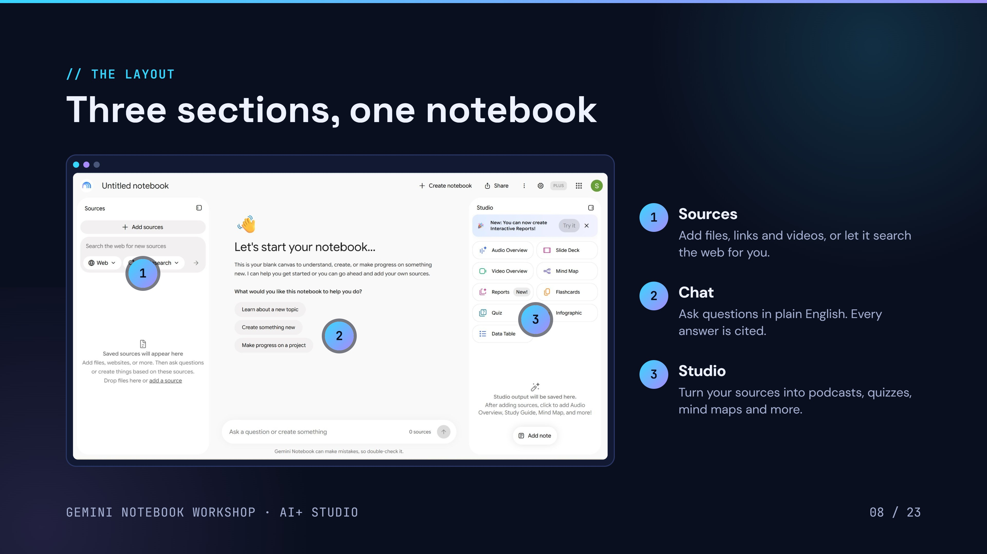
Sources
3
Studio
Chat
Studio Output
09 / 24
Notes:
This is what a brand new notebook looks like. Three sections: Sources on the left for everything you add, Chat in the middle for questions, and Studio on the right for one-click outputs like Audio Overviews and quizzes. Point out the Add sources button and the Fast Research search box.

Slide 11
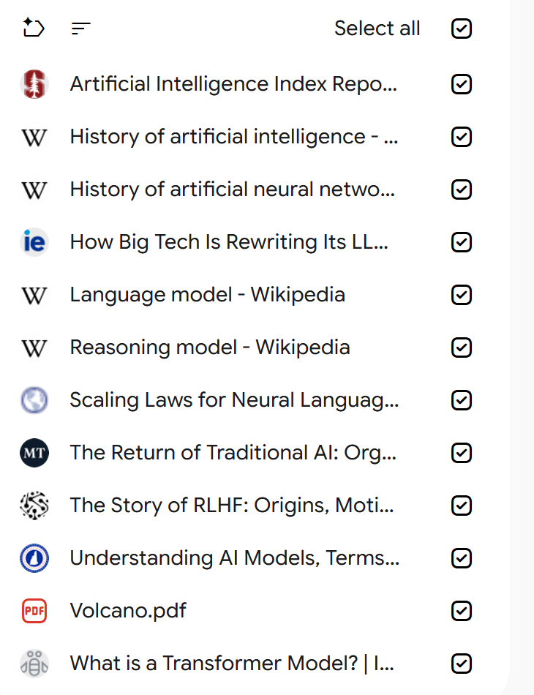
// OUR DATA
Our data sources
We will work with two types of data sources:
Sources in our notebook
1
Artificial intelligence data
Includes
11 sources: AI Index report, Wikipedia histories, and articles on LLMs, transformers and RLHF
2
Volcano data
Includes
1 source: Volcano.pdf
GEMINI NOTEBOOK WORKSHOP · AI+ STUDIO
10 / 25
Notes:
Besides uploading files, the Sources panel can find material for you. Fast Research (since Nov 2025) searches the web and your Google Drive and gives quick picks. Deep Research searches the web only on our plan and writes a full report with suggested sources. Either way, you choose what gets imported.

Slide 12
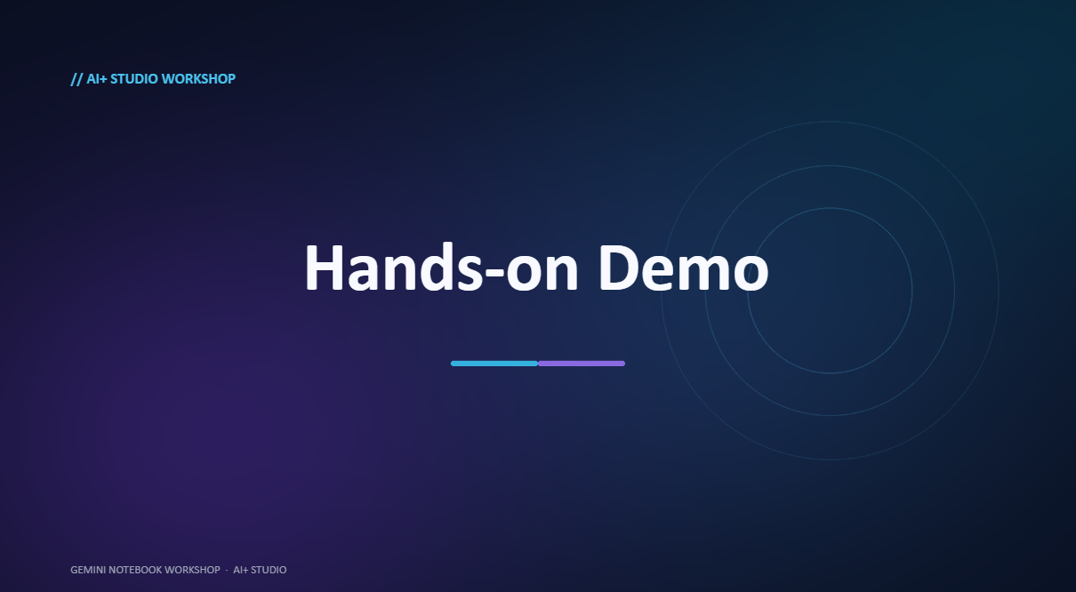

Slide 13
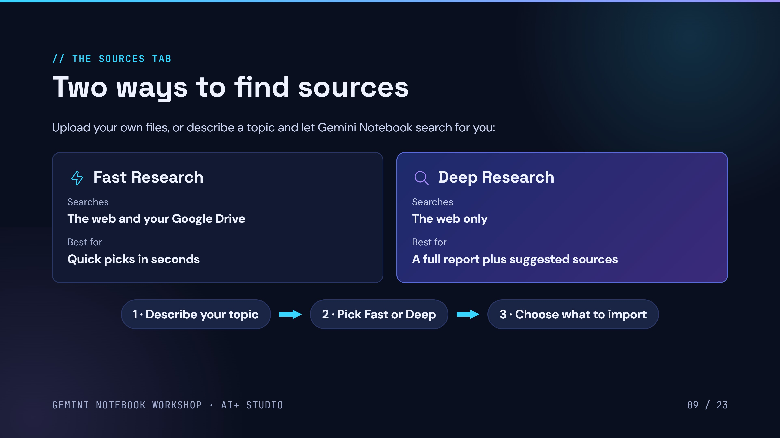
Three ways to bring in sources
Fast Research
Deep Research
Create a note
Searches
The web and your Google Drive
Best for
Quick picks in seconds
Searches
The web only
Best for
A full report plus suggested sources
Start from
A Gemini answer, or your own typing
Then
Add it as one of your sources
1 · Describe your topic
2 · Pick Fast, Deep or Add note as source
3 · Choose what to import
10 / 24
Notes:
Besides uploading files, the Sources panel can find material for you. Fast Research (since Nov 2025) searches the web and your Google Drive and gives quick picks. Deep Research searches the web only on our plan and writes a full report with suggested sources. Either way, you choose what gets imported.

Slide 14
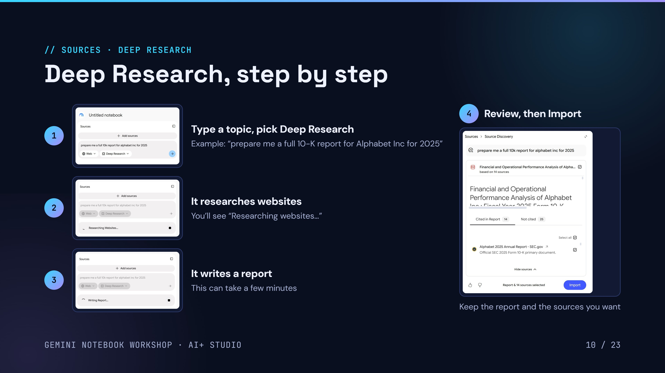
11 / 24
Notes:
Live demo of Deep Research. 1: type the topic in the Sources search box and switch Fast Research to Deep Research. 2: it browses websites. 3: it writes a report. 4: review the report, see which sources were cited (14 here) and which weren't, tick what you want and hit Import. The report itself becomes a source.

Slide 15
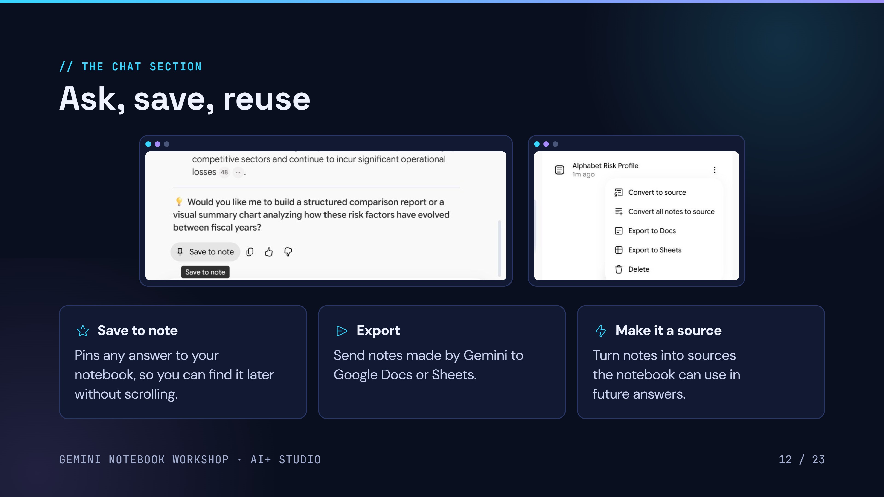
13 / 24
Notes:
Save to note sits under every answer and pins it to the Studio panel as a note, so you don't have to scroll back through chat. From a note's three-dot menu you can export it to Docs or Sheets (for notes Gemini created; notes you type yourself can't be exported) or convert it to a source. Ask the audience: why might turning notes into sources be useful? (It builds up context, so future answers get smarter.)

Slide 16
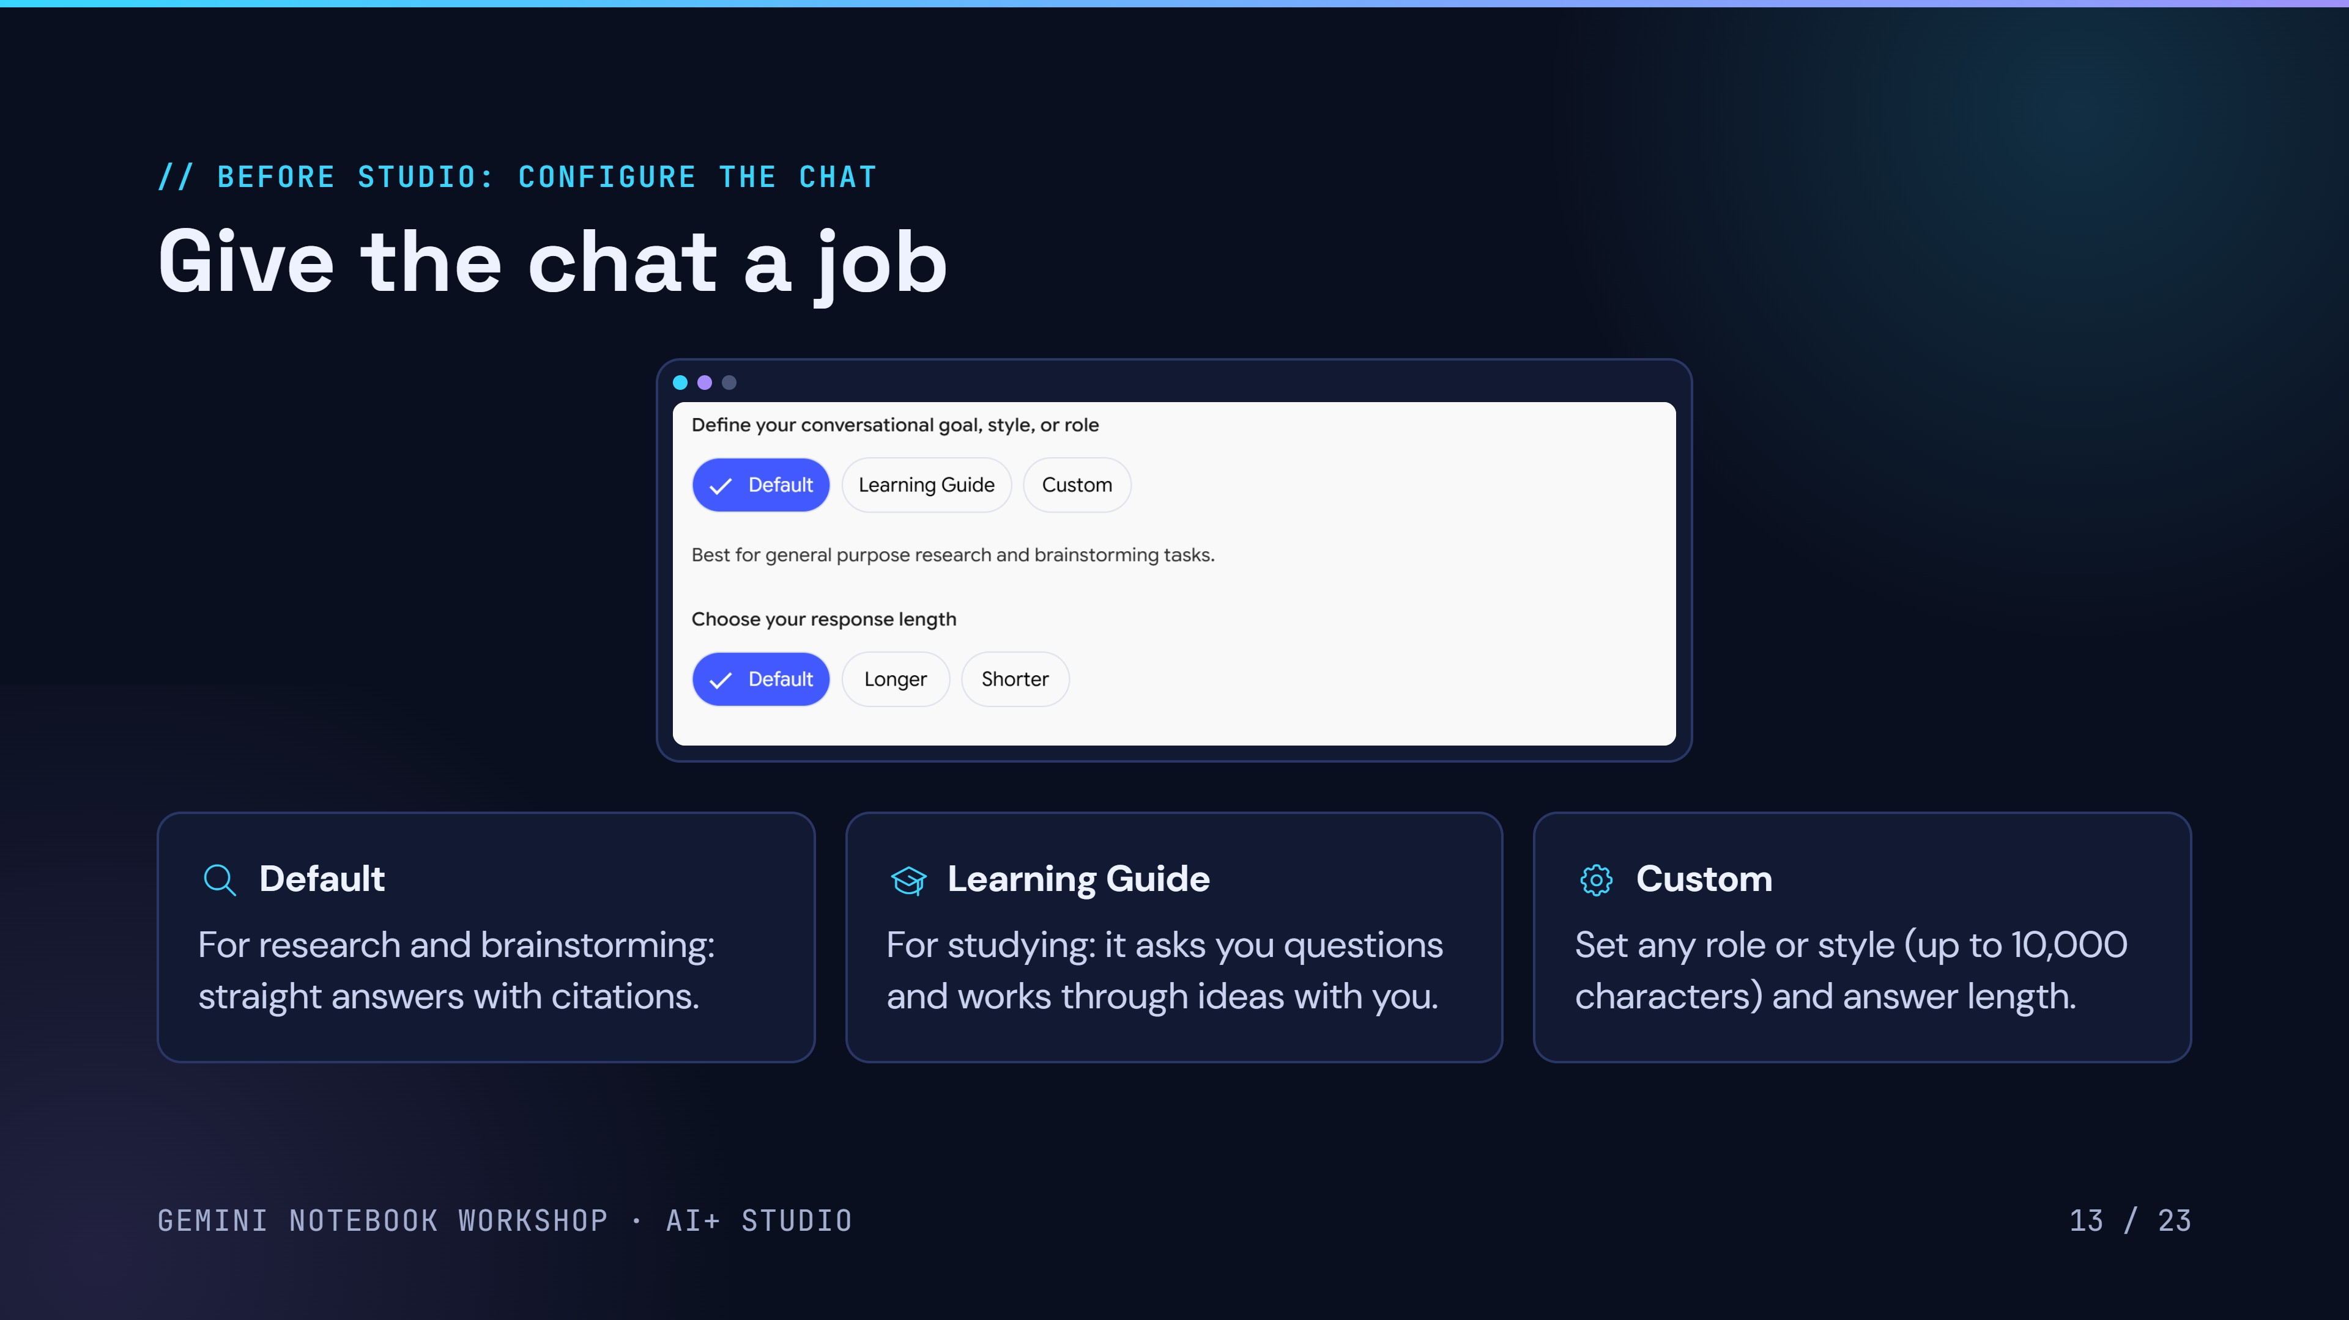
14 / 24
Notes:
Configure chat. Default is best for general research and brainstorming. Learning Guide is tutor mode: it works through the ideas with you instead of handing over the answer. Custom lets you set a role or style, like respond at a PhD level, up to 10,000 characters. You can also pick response length: default, longer or shorter.

Slide 17
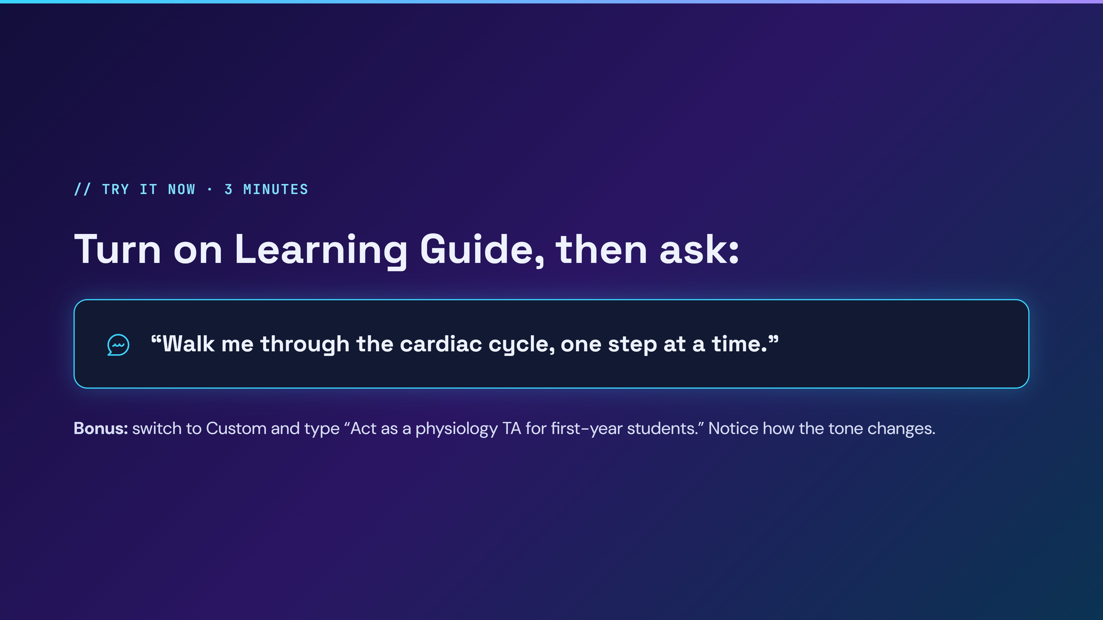
Notes:
Give everyone three minutes. Walk the room. Point out that Learning Guide asks you questions back instead of dumping the answer. If people don't have their own materials, use the shared demo notebook.

Slide 18
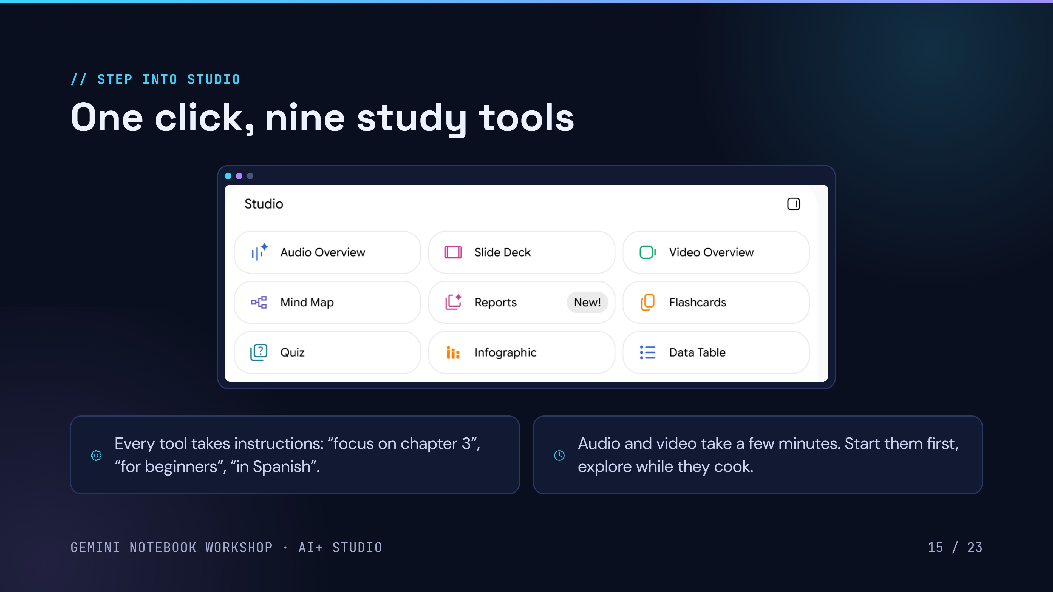
16 / 24
Notes:
Studio has nine generators: Audio Overview, Slide Deck, Video Overview, Mind Map, Reports, Flashcards, Quiz, Infographic and Data Table. Each one can be customized with instructions. Start an Audio or Video Overview now so it's ready later.

Slide 19
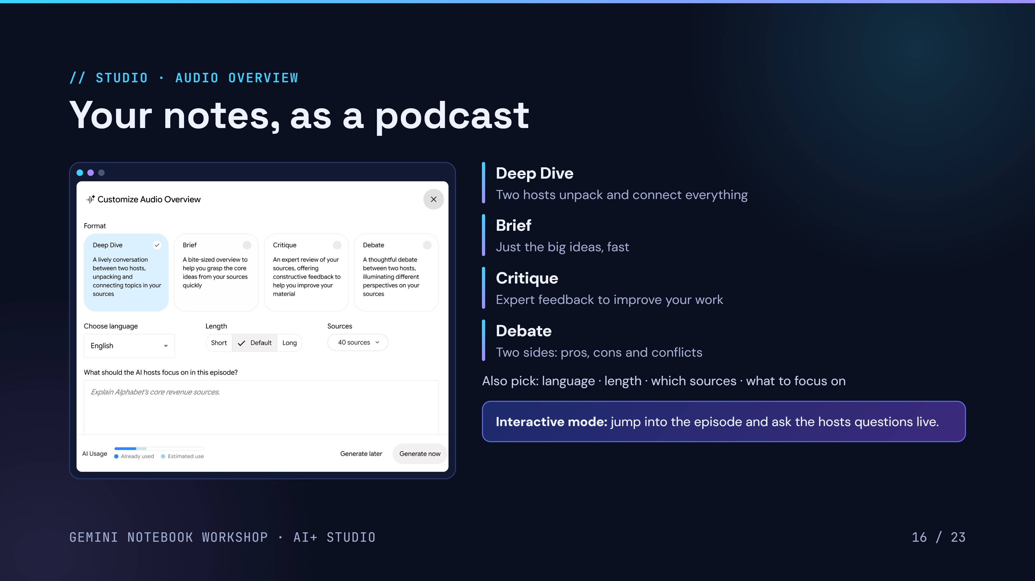
17 / 24
Notes:
Four formats: Deep Dive (two hosts unpack and connect topics), Brief (quick overview), Critique (expert feedback on your material) and Debate (two perspectives). Pick language, length, which sources and a focus. The AI Usage bar shows how much a generation will cost; if you're running low, hit Generate later. Interactive mode lets you join the episode and ask the hosts questions.

Slide 20
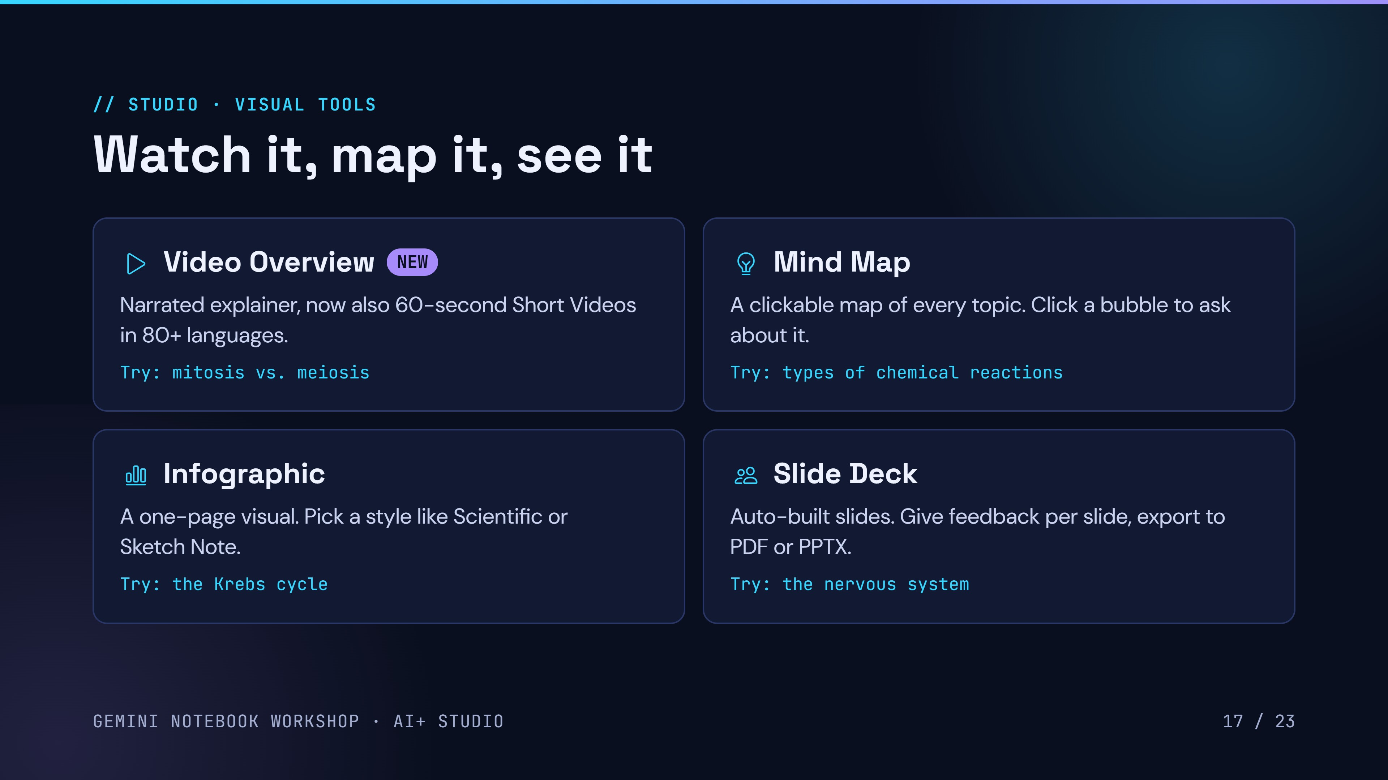
18 / 24
Notes:
Video Overview: narrated explainer; new 60-second Short Video Overviews in 80+ languages. Mind Map: click any node to ask about it. Infographic: pick a style. Slide Deck: revise per slide and export as PDF or PPTX.

Slide 21
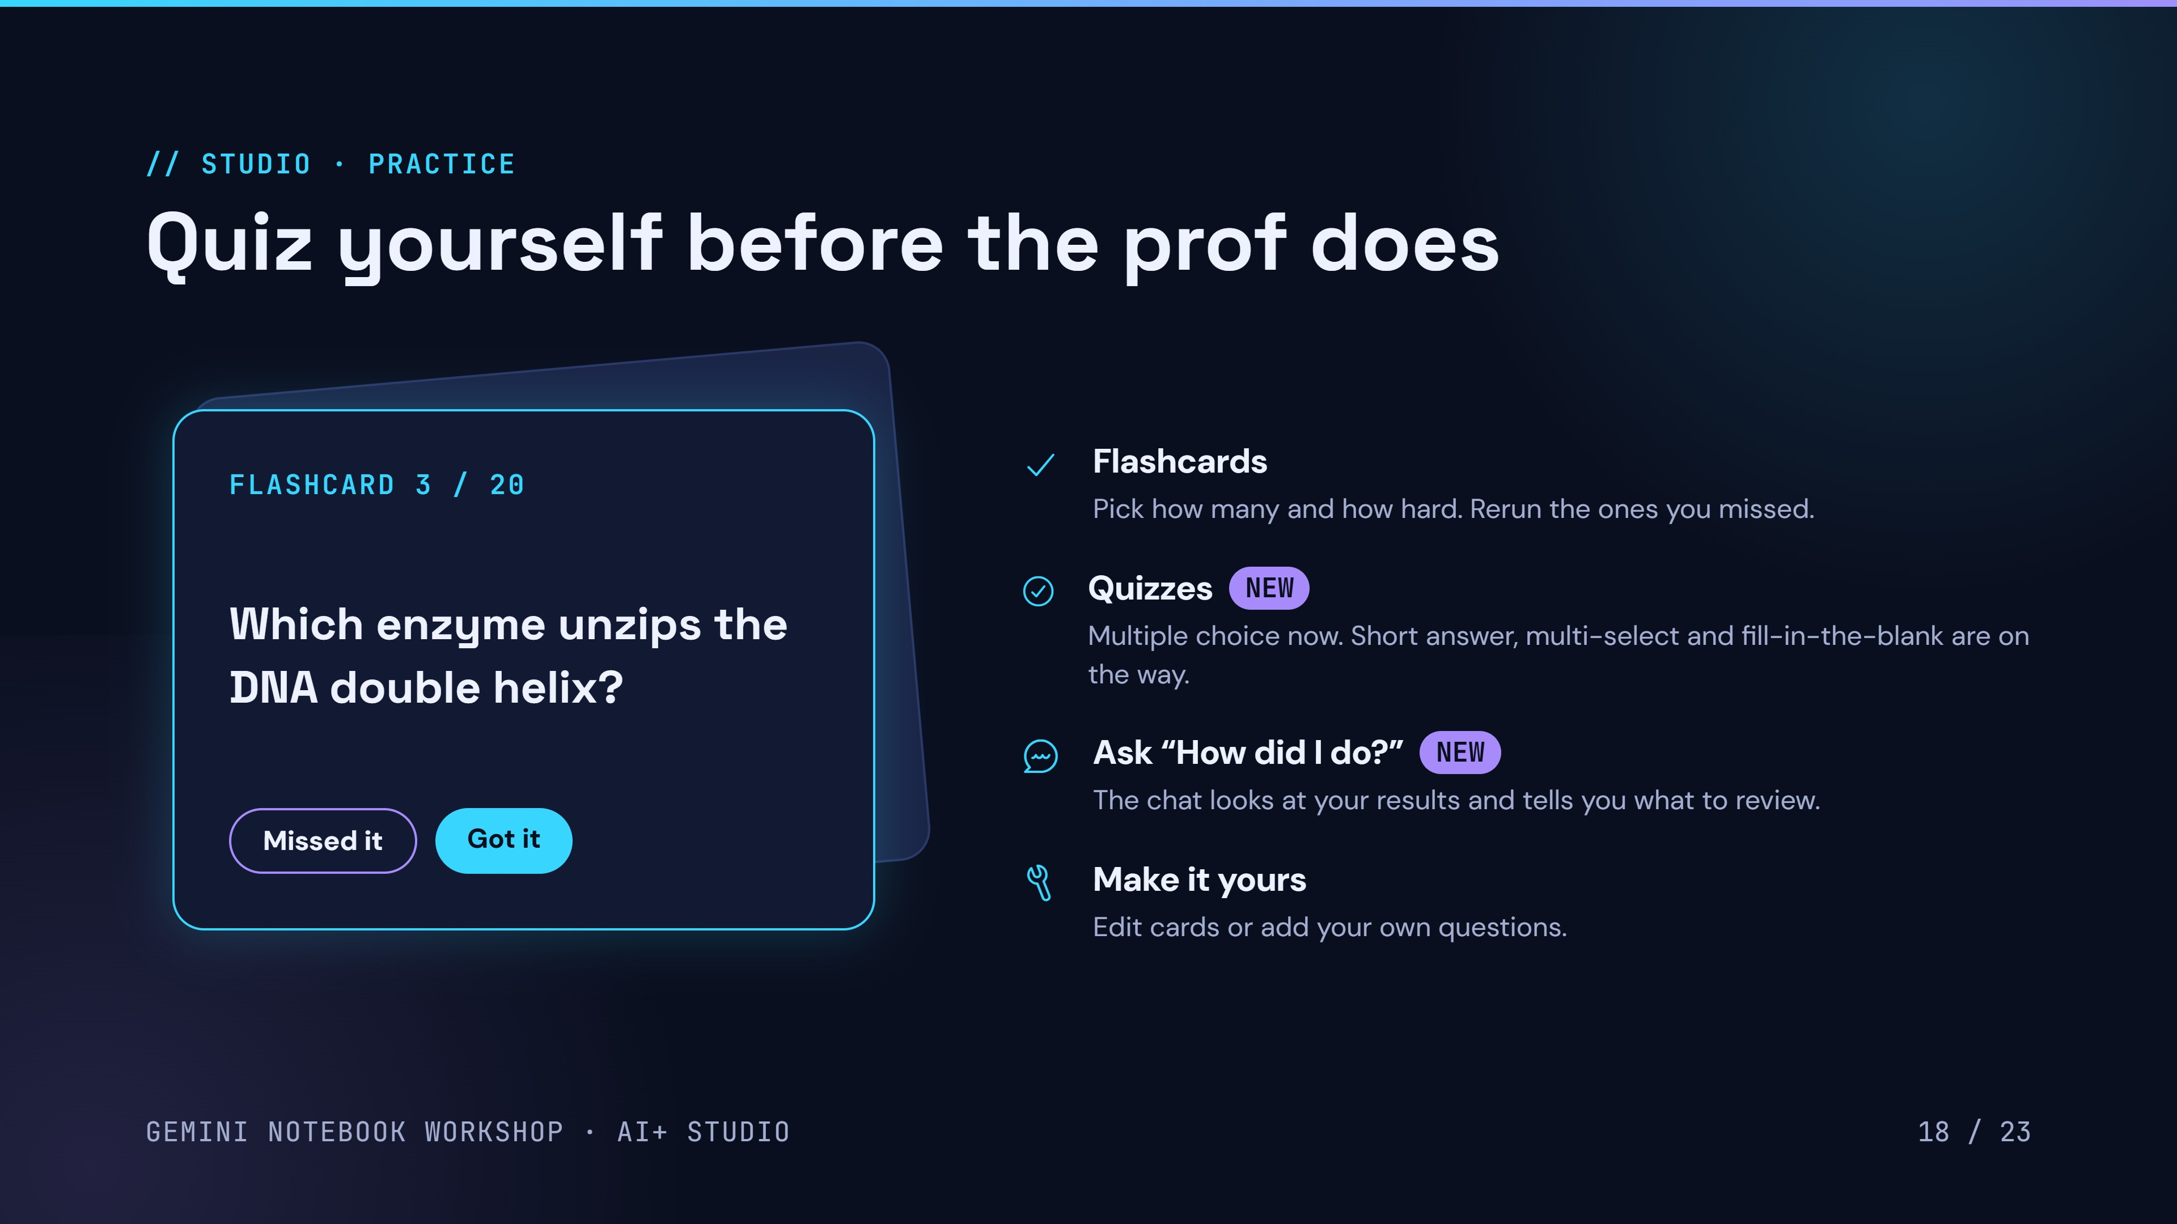
19 / 24
Notes:
Flashcards: set count and difficulty, mark Got it or Missed it, rerun missed cards. Quiz: set count and difficulty; new formats are rolling out. After a quiz, ask the chat how you did to find weak spots. You can edit or add your own questions.

Slide 22
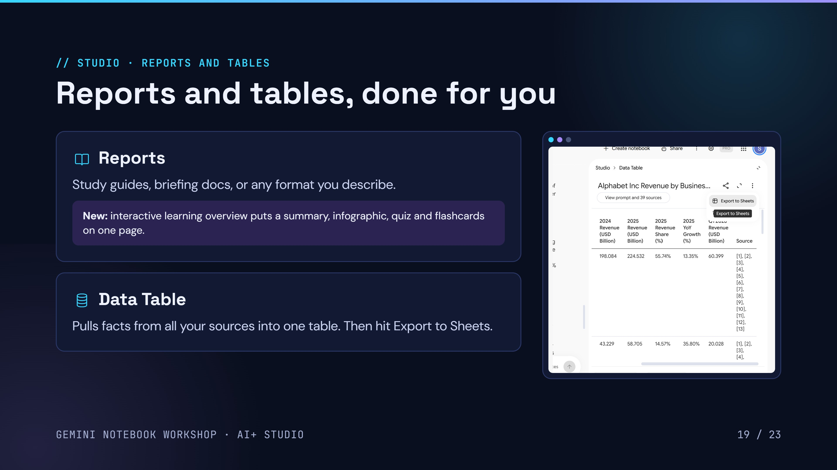
20 / 24
Notes:
Reports: study guide, briefing doc, or a custom format; new interactive learning overview combines a summary, infographic, quiz and flashcards. Data Table: pulls facts from all sources into a table with citations, then Export to Sheets.

Slide 23
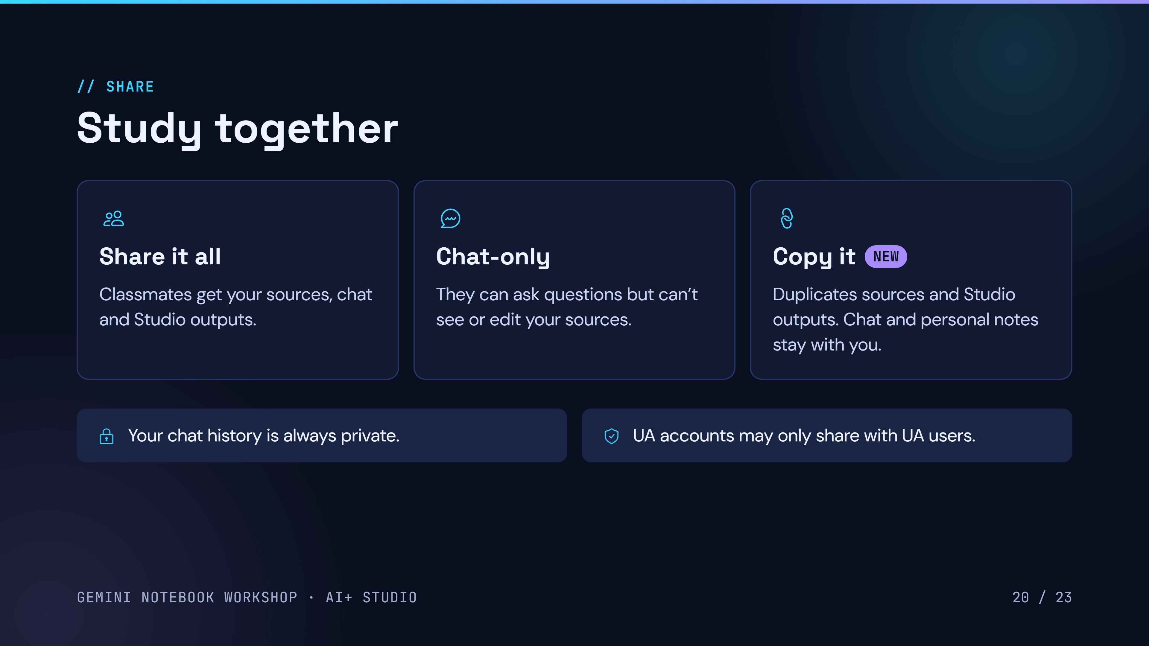
21 / 24
Notes:
Share the full notebook or chat-only (they can ask questions but can't see your sources). Copy a notebook duplicates sources and Studio outputs but not chat history or personal notes. Chat history is always private.

Slide 24
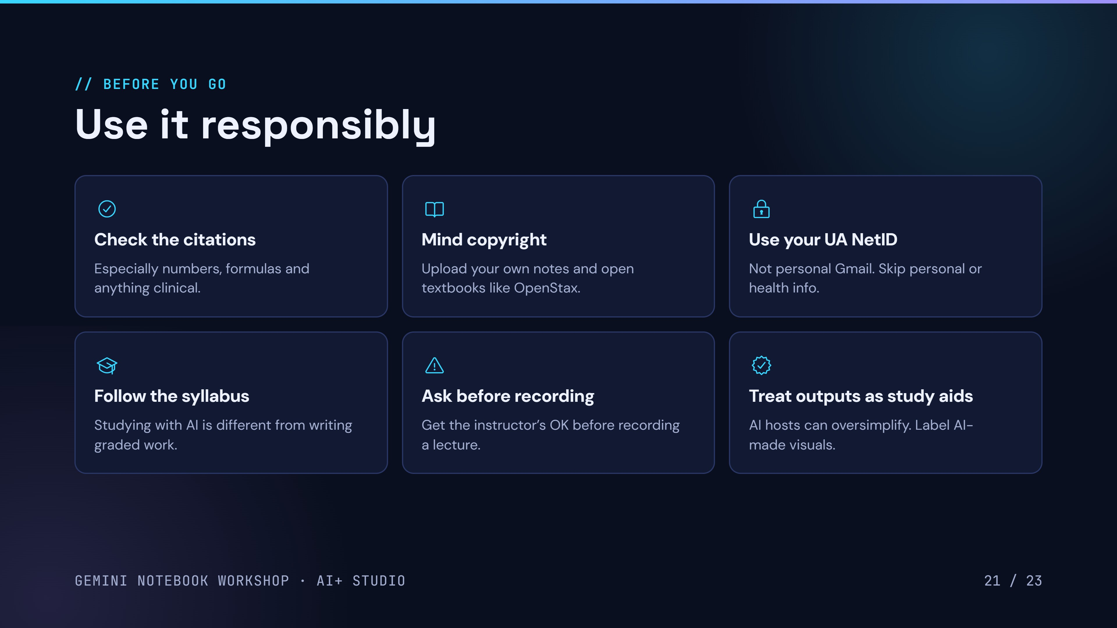
22 / 24
Notes:
Grounding cuts errors but doesn't remove them, so click citations. Many readings are licensed, so don't upload them without permission. Use your UA NetID so education data protections apply. Check each course's AI policy. Ask before recording lectures. Label AI-made visuals in presentations.

Slide 25
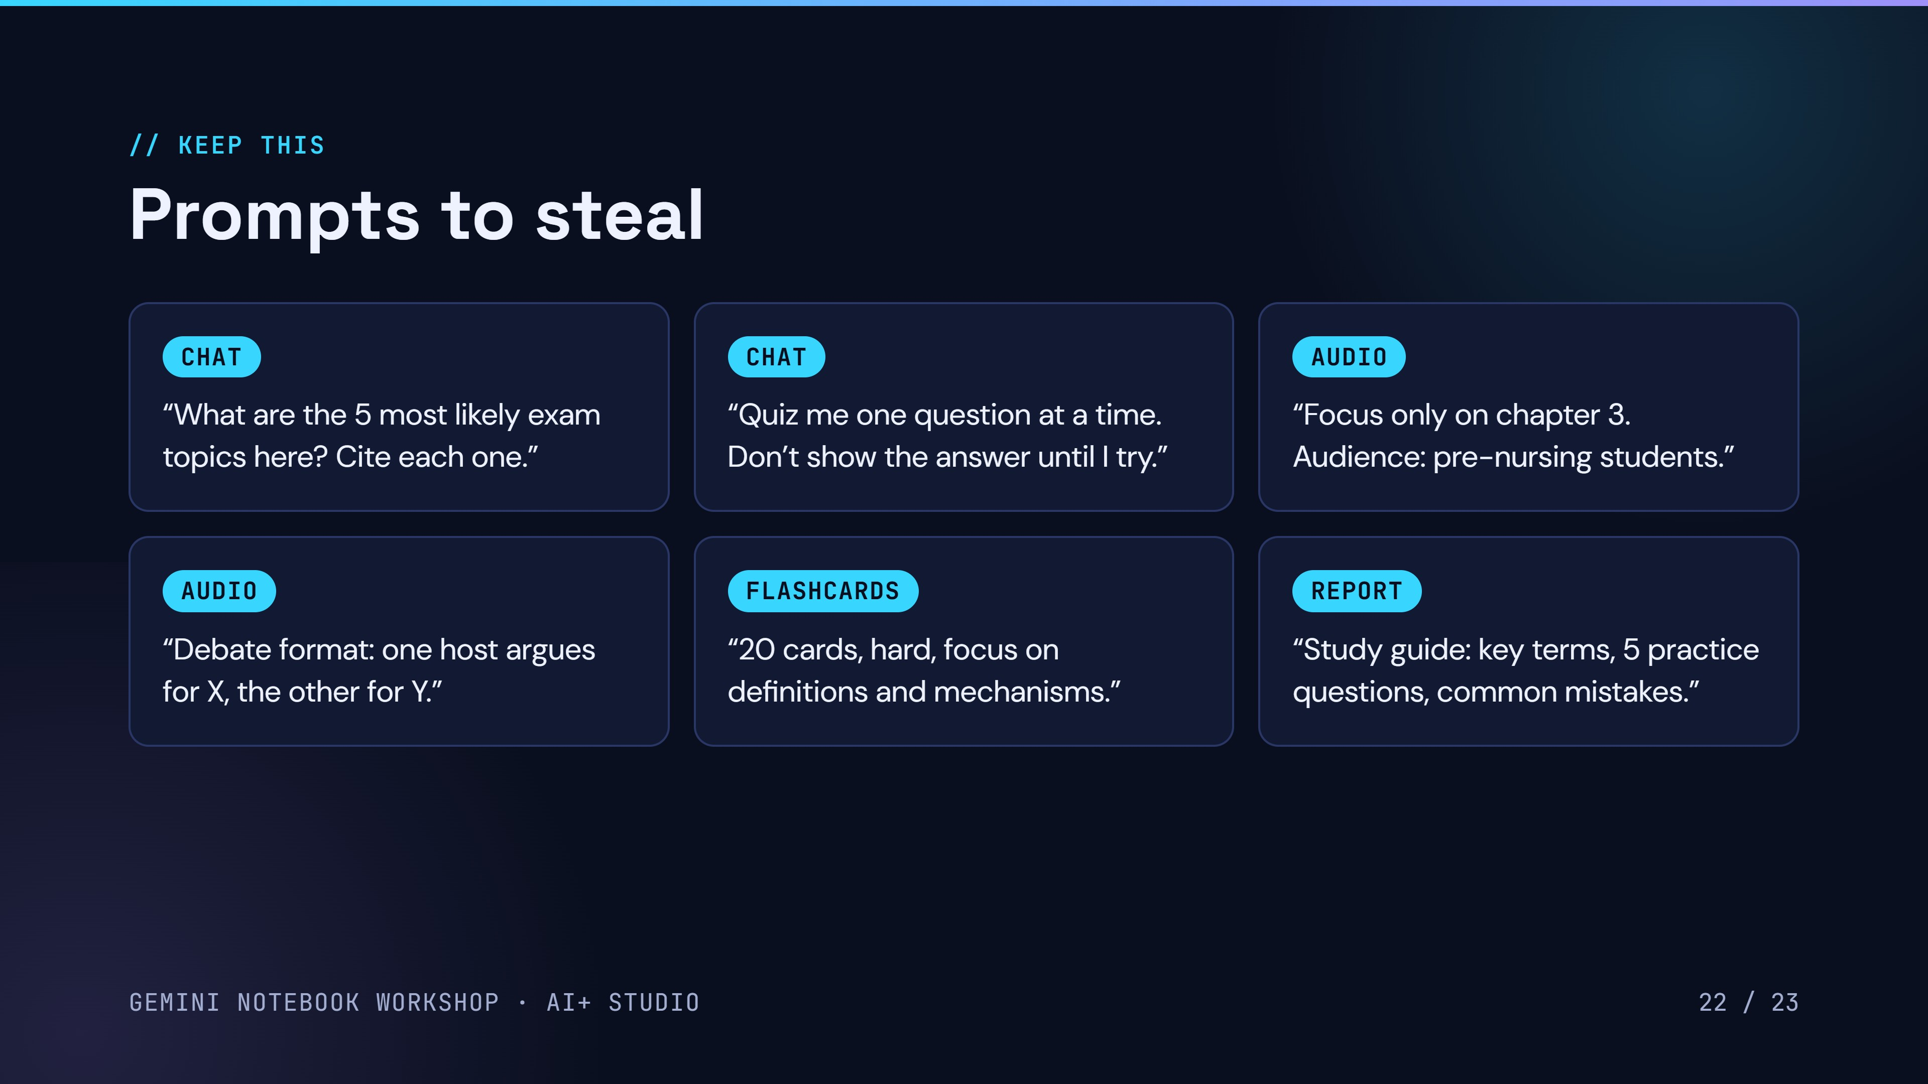
23 / 24
Notes:
Tell people to screenshot this slide. More ideas: compare mitosis and meiosis in a table; what in these sources contradicts itself; write questions in the style of the past exam I added.

Slide 26
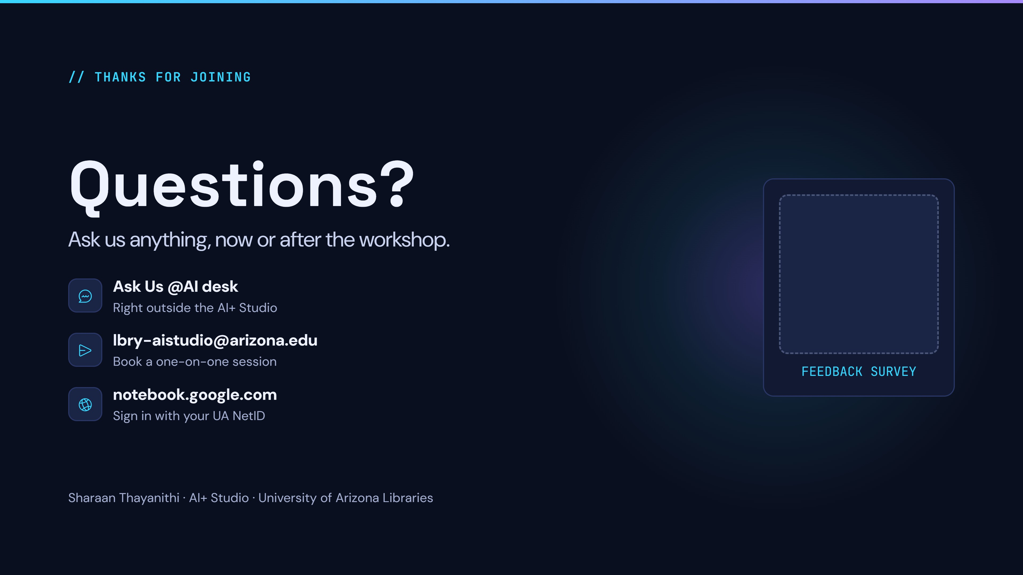
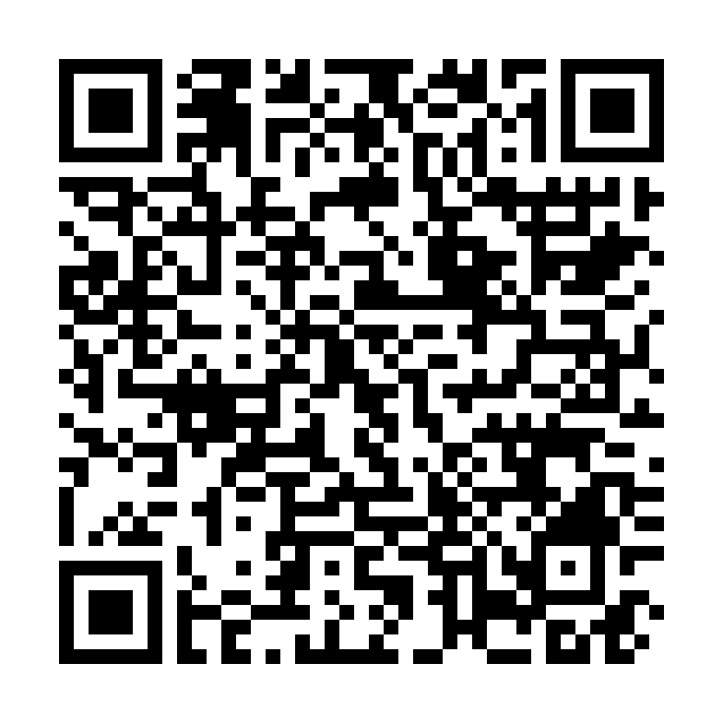
Notes:
Open the floor. Point people to the Ask Us @AI desk and lbry-aistudio@arizona.edu for follow-up help, and ask them to fill in the feedback survey before they leave.

